Slide 1
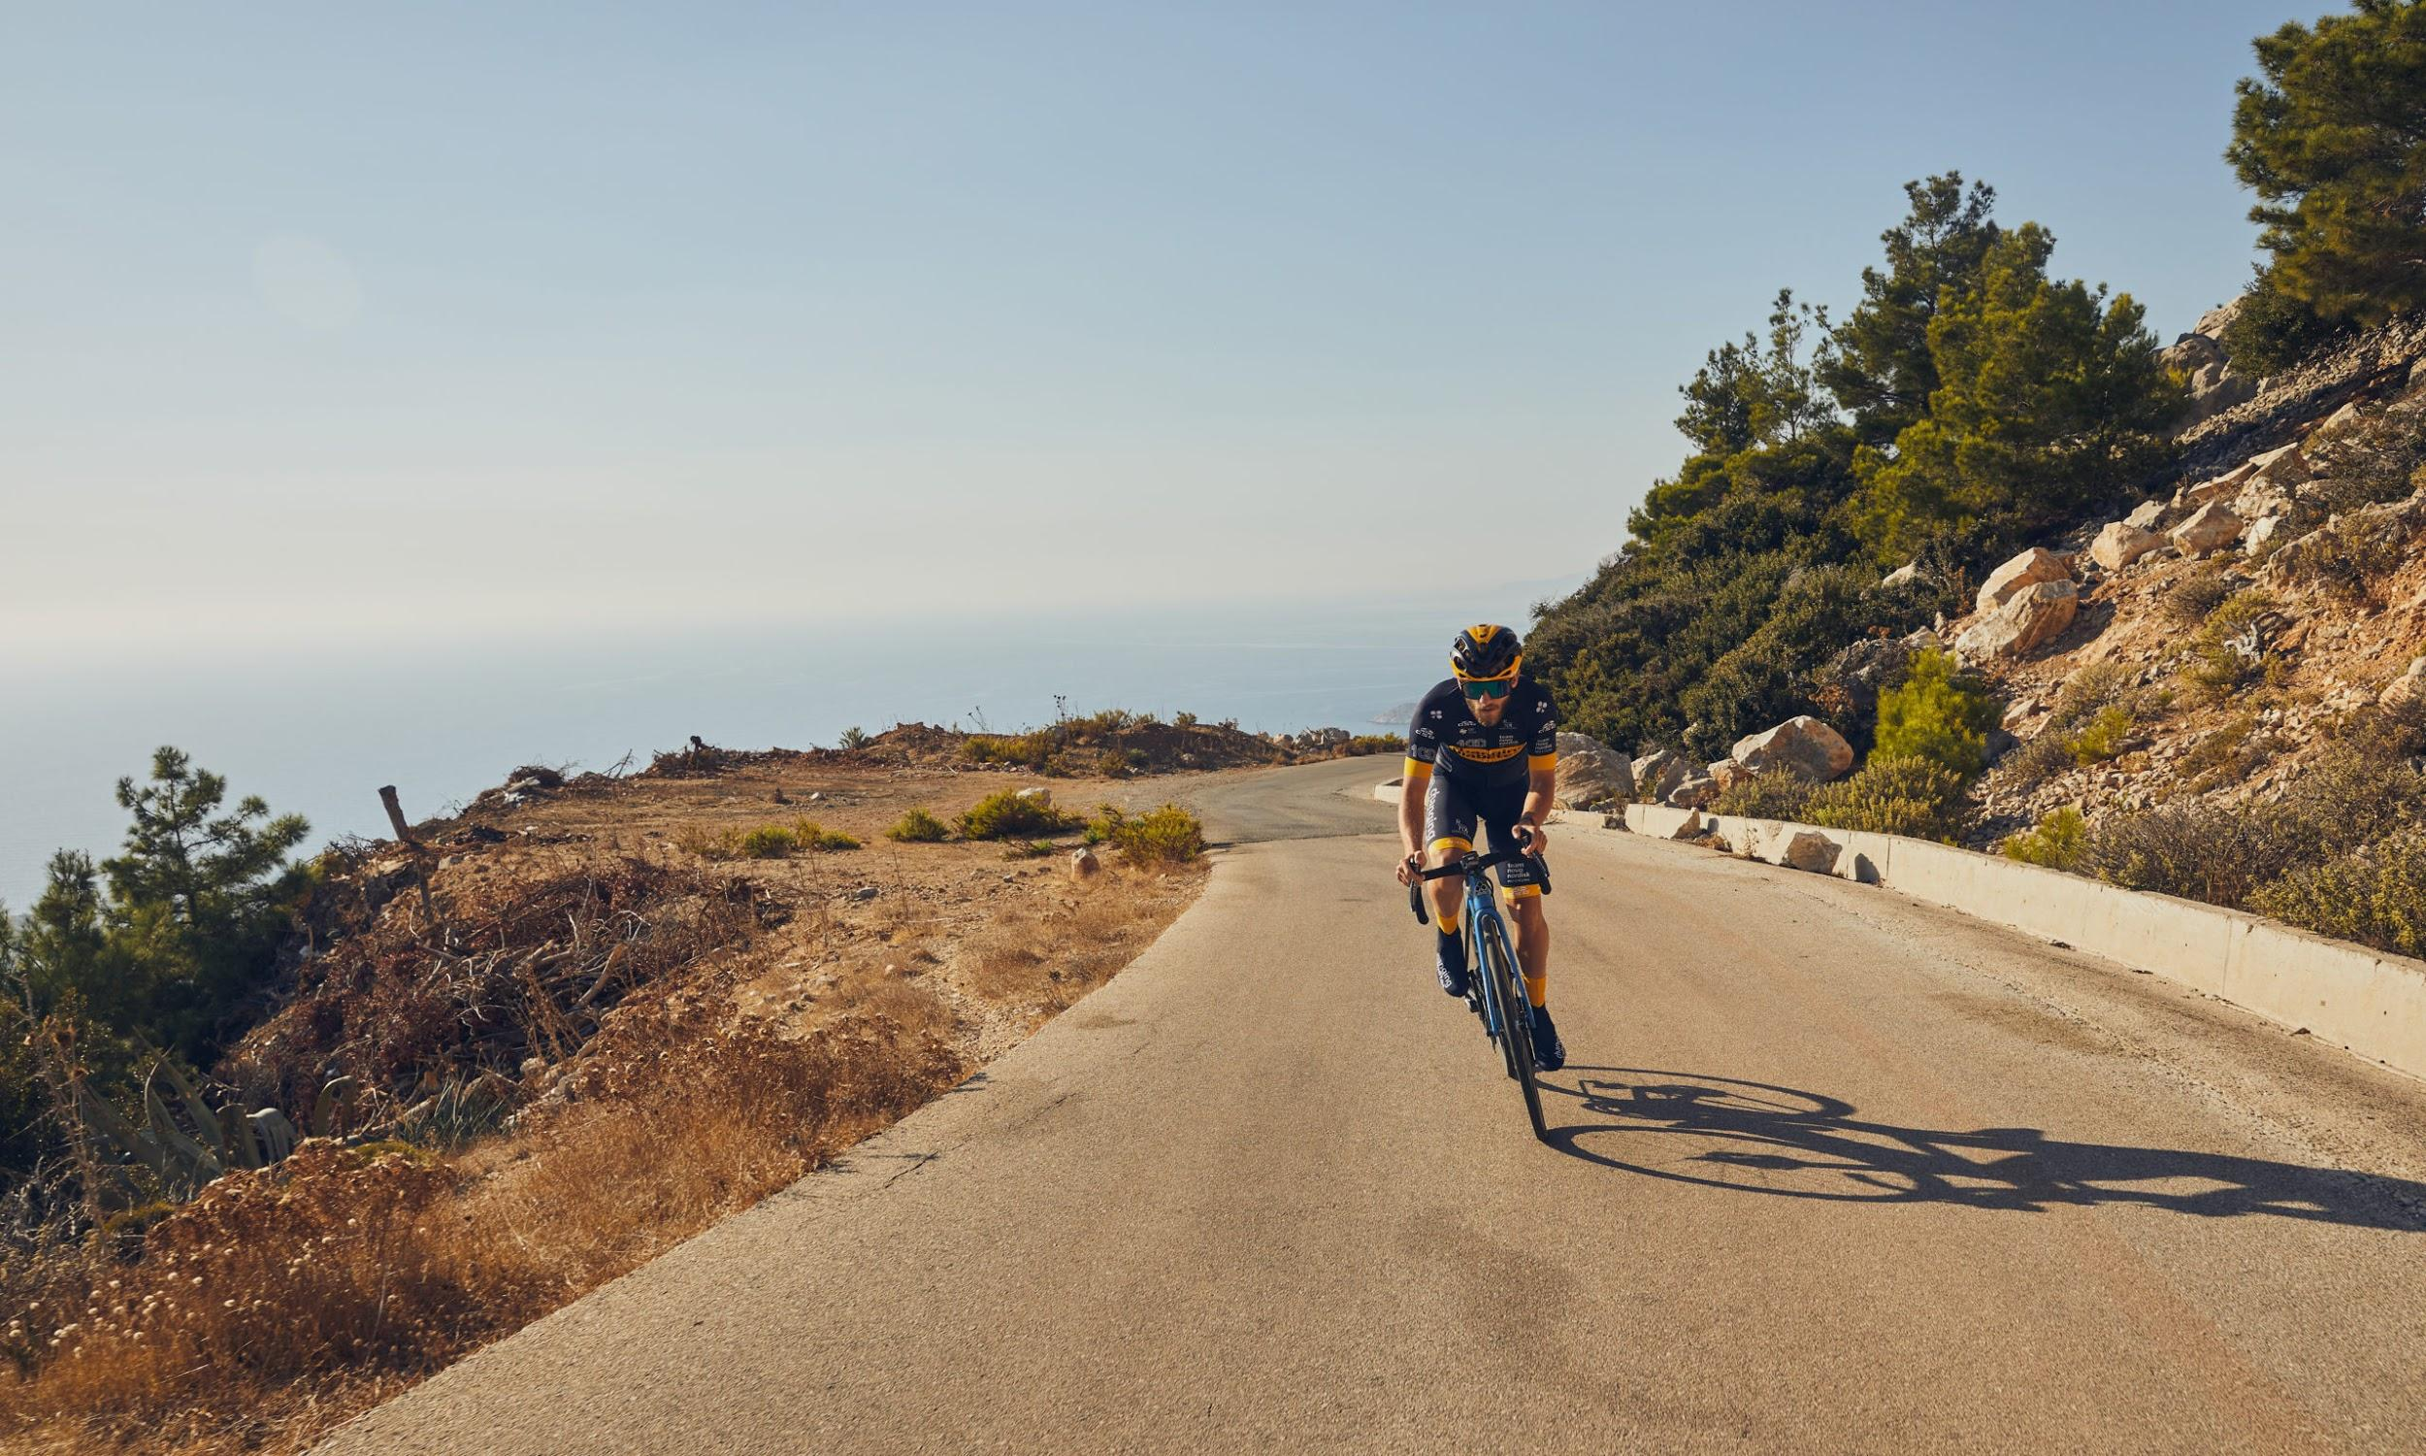
Cycling analytics
Meeting | June 30, 2021

Slide 2

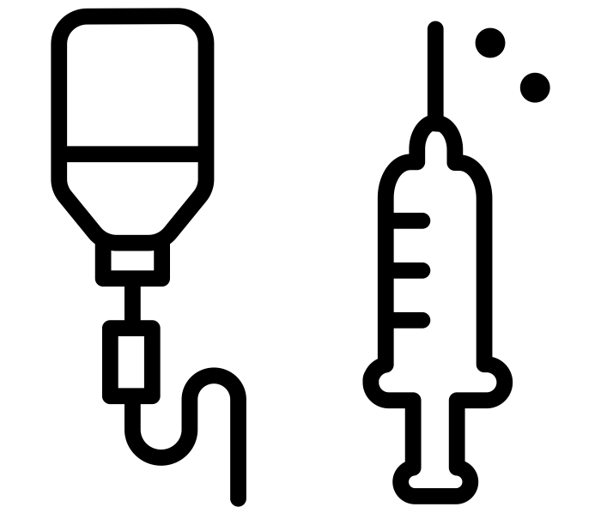
Data - Team Novo Nordisk
11 professional cyclists over the course of one training season (Dec 2018 - Nov 2019)
Cycling
Glucose
Notes:
For this project we are analyzing the data of Team Novo Nordisk. This is a professional cycling team solely consisting of people with type 1 diabetes. They closely manage their diabetes while training and competing at a professional level. The data from Team Novo Nordisk consists of the cycling data and glucose data of 11 professional athletes over the course of one training season (year).

Slide 3

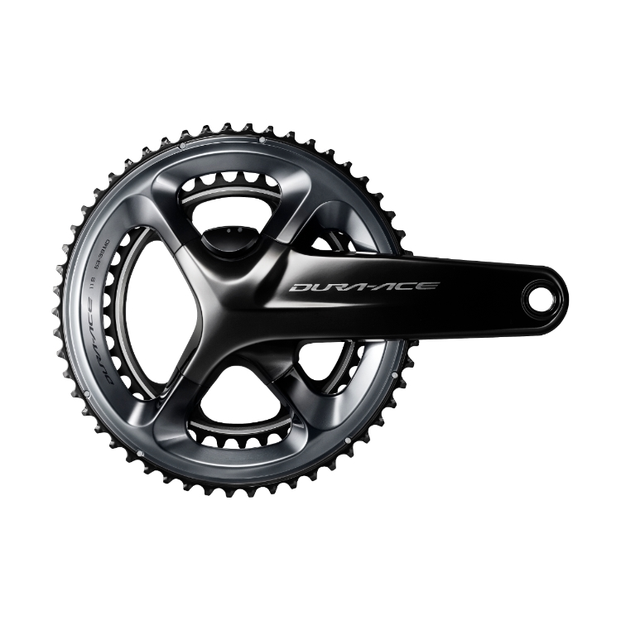
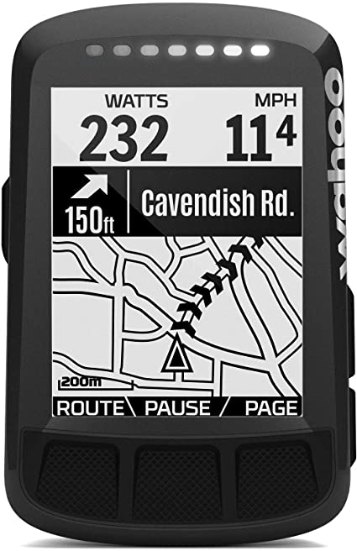
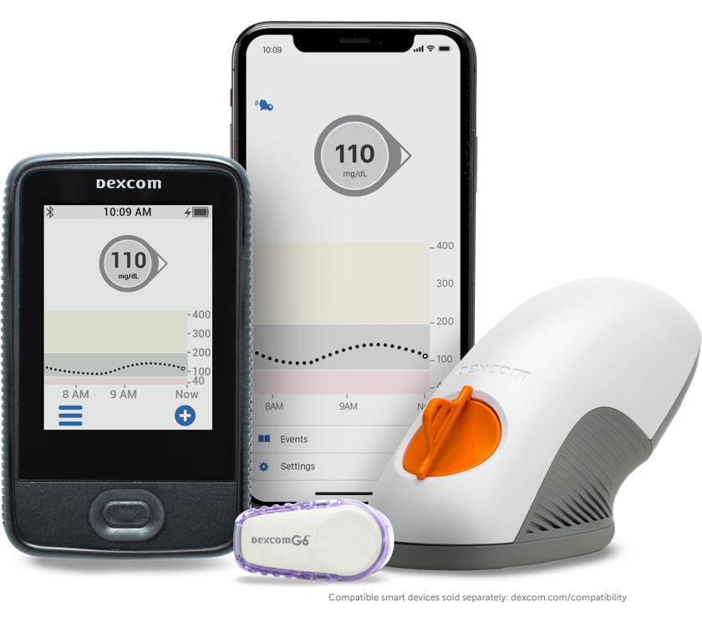
Data - Team Novo Nordisk
11 professional cyclists over the course of one training season (Dec 2018 - Nov 2019)
Cycling
Glucose
heart rate power bike computer
CGM (dexcom)
Notes:
The data that we have during their training sessions consist of a heart-rate band, a power monitor (which can also distinguish between left and right), as well as a bike computer (giving insights into the location, speed, altitude, etc.). This data is at a 1 second interval during each training session. In addition to that, these athletes use the real-time continuous glucose monitoring system “dexcom”, which tracks glucose levels continuously at a 5 minute interval. Note that the glucose levels are measured in the interstitial fluid, which shows a 15 minute delay with respect to the blood.

Slide 4

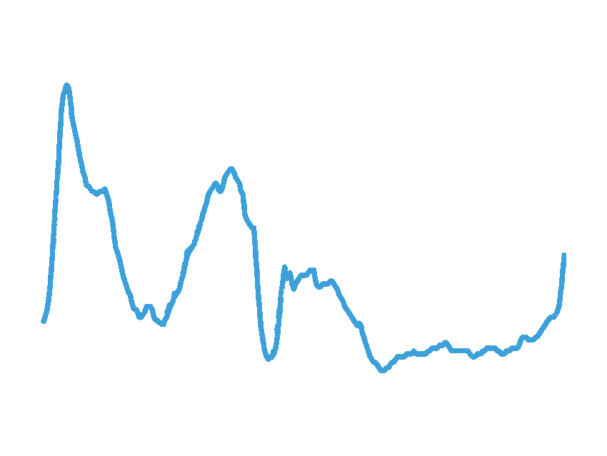
Early warning system that detects dysglycaemia
food
heart rate
Hyperglycaemia
power
Blood glucose
bike computer
insulin
Hypoglycaemia
machine learning model
Time
CGM (dexcom)

Slide 5
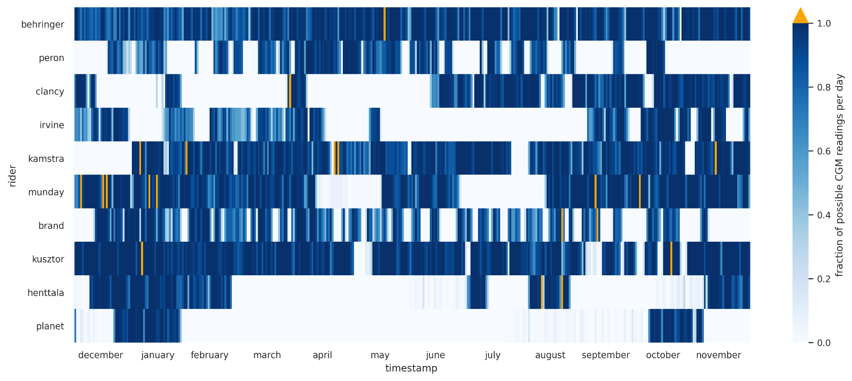
Glucose availability

Slide 6
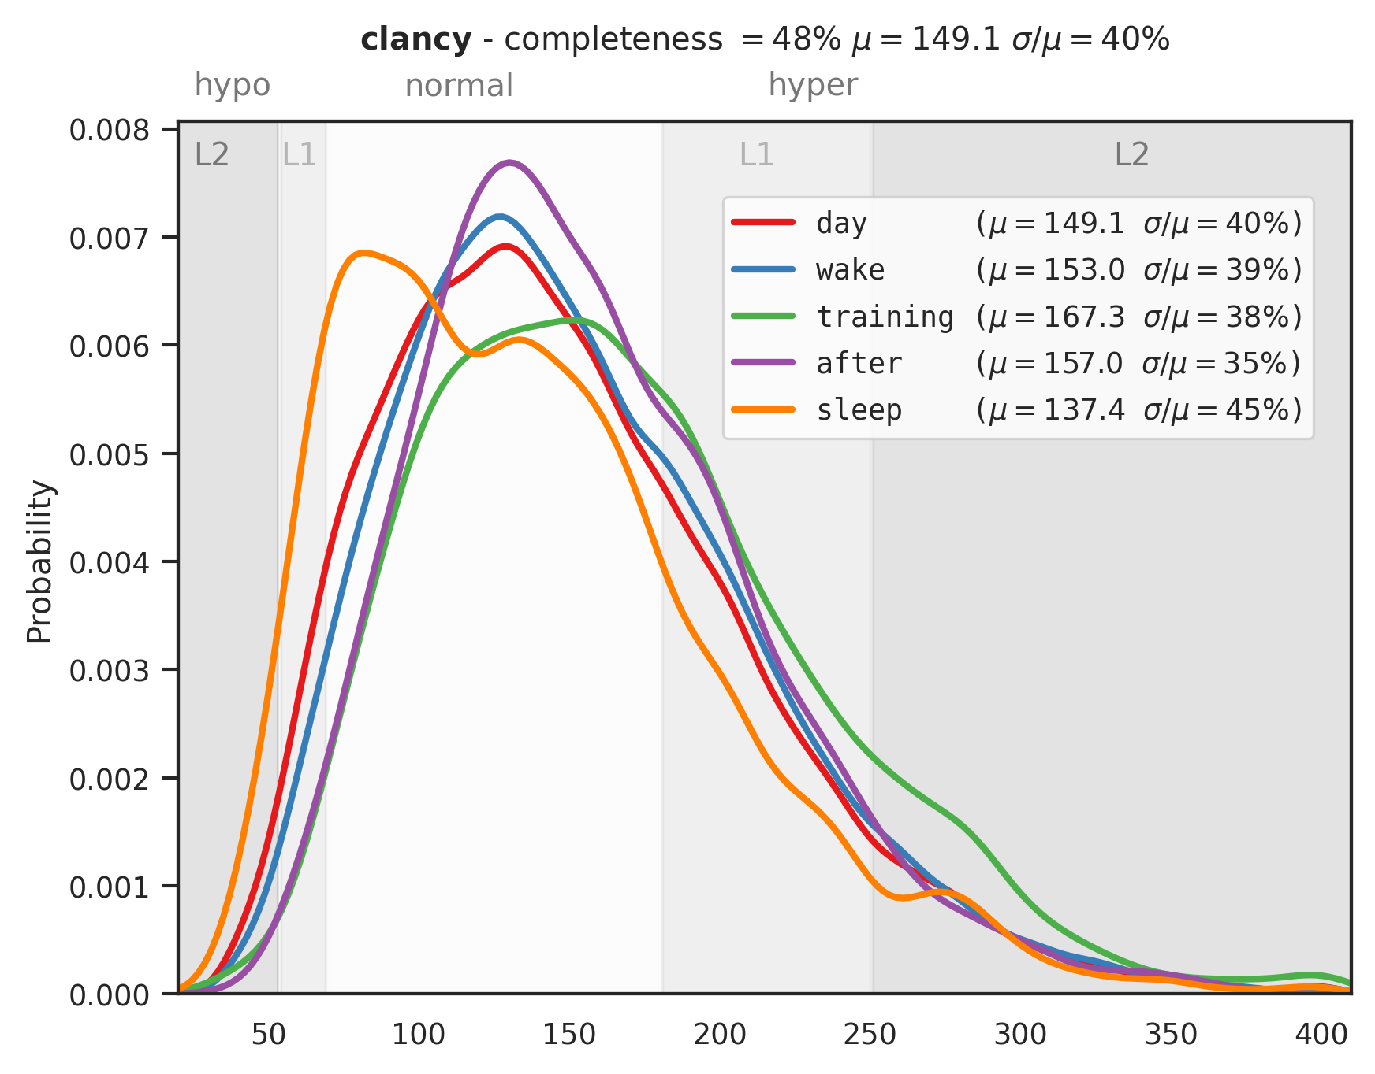
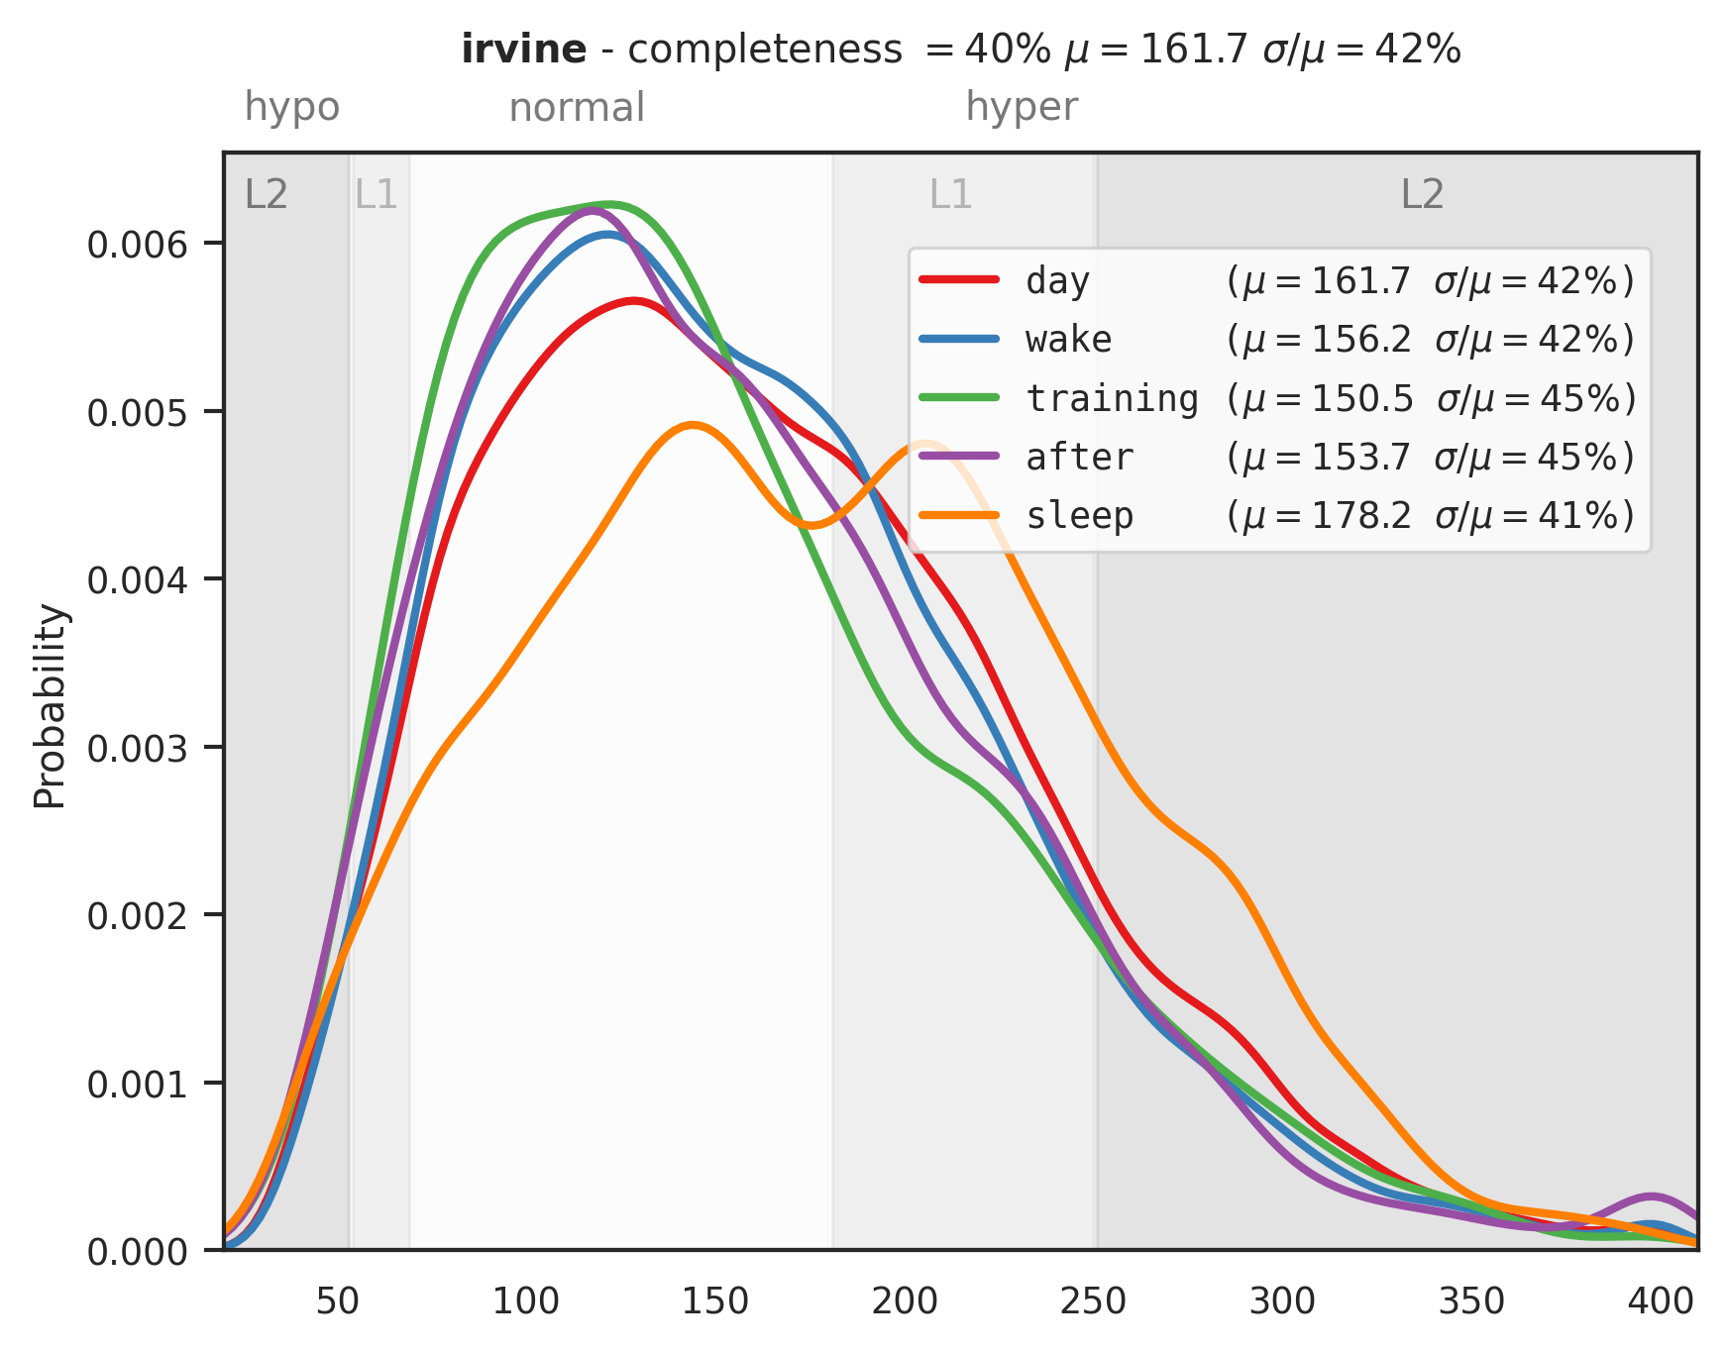
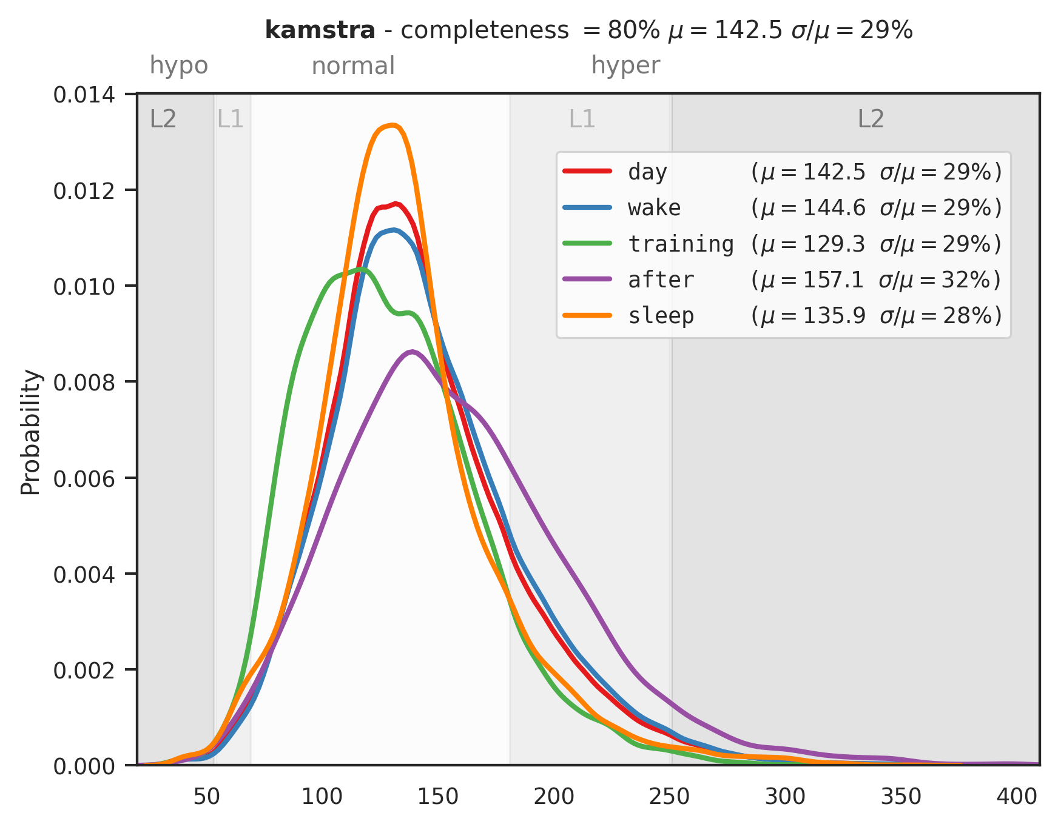
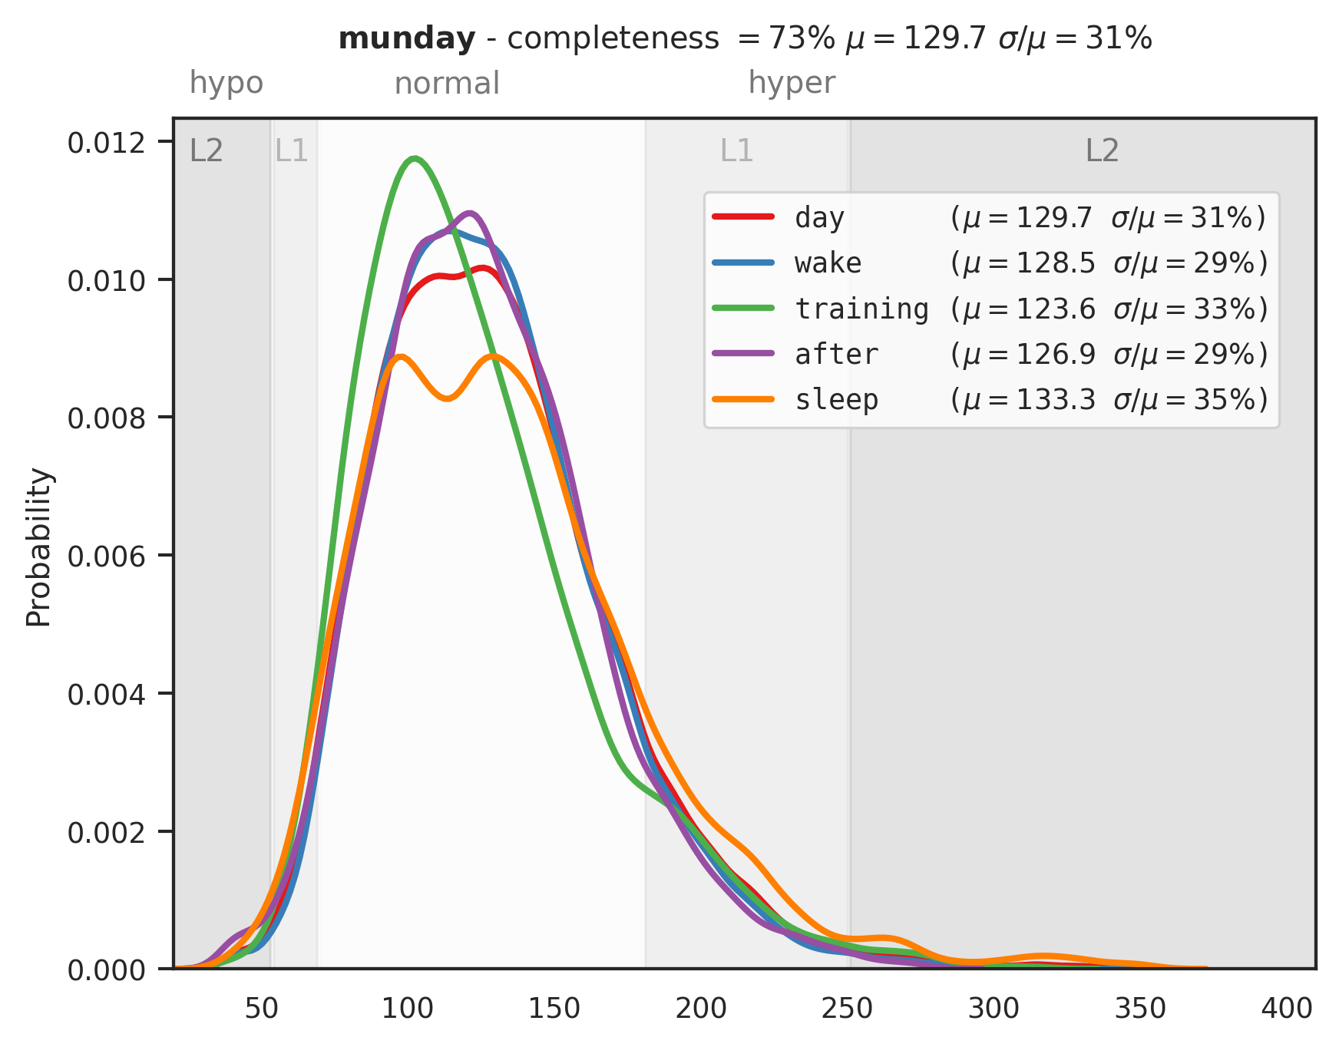

Slide 7
